Slide 1



Chicago Transportation Network Providers (TNPs) & Taxis: Travel Demand Forecasting
QST 843 - Team 8: Olivia Chen, Albert Dahlberg, Pratik Mahajan, Brendan Wilcox, Roxy Zhang
Notes:
Good evening everyone
Today we will be presenting our project on travel demand forecasting for Chicago’s Transportation Network Providers and taxi system.

Slide 2
Table of Contents
01
02
03
04
Project Overview
Data Description
Machine Learning
Findings
05
06
07
Recommendations
Challenges & Limitations
Q&A
Notes:
Here is the flow of our presentation

Slide 3
Project Overview
Problem Definition
Riders lack transparency on where rides will be cheapest and fastest.
Drivers cannot easily identify where profitable demand will occur.
Current ecosystem is inefficient despite abundant TNP activity.
Motivation
TNP dominance leaves riders and drivers with inconsistent outcomes.
Riders face surge pricing and long waits; drivers see shrinking margins.
Better insight into demand can help both groups make smarter decisions.
Proposed Solution
Build a unified demand-forecasting system to guide riders and drivers in real time.
Use predictions to help drivers position themselves in high-volume areas, improving prices and access.
Identify emerging low-demand neighborhoods where drivers can capture new value.
Notes:
I’ll start with the project overview—what issue we’re solving and why it matters
Although TNPs and taxis offer the same service, the system isn’t efficient for riders or drivers. Riders don’t know where rides will be fastest or cheapest, and drivers lack visibility into where demand will be profitable.
Our goal is to support both groups. Riders face surge pricing and long waits, while drivers deal with shrinking margins and inconsistent demand. Better demand transparency can help both sides make smarter decisions.
So we propose a unified, neighborhood-level forecasting system which shows where demand is rising, helping drivers position themselves in high-volume areas and revealing emerging neighborhoods where new value can be captured.

Slide 4
Data Description
Transportation Network Providers – Trips (2018–2022)
Taxi Trips (2013–2023)
Source: City of Chicago Data Portal
Overview: Trip-level records for Uber and Lyft rides, including pickup/dropoff details, distances, durations, and fare components.
Features
Pickup & drop off timestamps and community areas
Trip miles, trip duration, and fare amounts
Surge multiplier, shared ride indicator, wheelchair-accessible indicator
Payment type, trip status, and company
Source: City of Chicago Data Portal
Overview: Historical taxi trip records with detailed trip, fare, and meter information across Chicago’s licensed taxi fleet.
Features
Pickup & drop off timestamps and community areas
Trip miles, trip duration, metered fare, tips, extras, taxes
Payment type and company affiliation
Pickup/dropoff GPS, trip status flags
‹#›
Notes:
To build this system, we used two major datasets from the City of Chicago Data Portal.
The TNP dataset covers detailed Uber and Lyft trips from 2018–2022 and the Taxi dataset covers taxi trips from 2013–2023, with information like Pickup & drop off timestamps, duration of trip and community areas

Slide 5
Data Processing & Preparation
Large-Scale Data Cleaning
Processed 250M+ trip records across TNPs and Taxis.
Standardized timestamp formats; removed invalid or incomplete trips.
Mapped geographic identifiers to 77 Chicago Community Areas.
Time & Space Aggregation
Converted raw trip timestamps into 15-minute intervals to match forecasting granularity.
Aggregated trips by (community area × 15-minute window) to create demand counts.
Ensured consistency across TNP and Taxi datasets.
1
2
3
Dataset Integration
Merged TNP, Taxi, and NOAA weather datasets into a unified analytical table.
Joined on timestamp
‹#›
Notes:
Our first step was large-scale cleaning and standardization. We processed millions of trip records, aligned timestamps, removed invalid entries, and mapped locations to Chicago’s 77 Community Areas.
We then aggregated all trips into 15-minute windows and brought in weather data. Finally, we engineered features like hour-of-day, day-of-week, and weather conditions, creating a unified dataset which was used to build the forecasting model.
Over to Eric to discuss our Machine Learning Approach

Slide 6
Machine Learning Approach
Data Preparation & Feature Engineering
Built lagged weather features:
  Precipitation and Temperature
Encoded community areas using StringIndexer + OneHotEncoder
Train / Test Strategy
Time-based split to respect chronological order:
Training: Feb 2021 → July 2022
Testing: July 2022 → End
~75% training data (~3.9M rows)
Goal: Predict rider demand in 15-minute intervals for each Chicago community area
Pipeline stages
Data Preparation and Feature Engineering → StringIndexer → OneHotEncoder → VectorAssembler → RandomForestRegressor
Notes:
String Indexer on the community areas and one hot encoded them
Sparse vector space - 96 columns
Emulate actual model creation…
Random Forest Models They also naturally capture non-linear relationships that simpler models (like linear regression) would miss, while avoiding the instability and overfitting problems

Slide 7
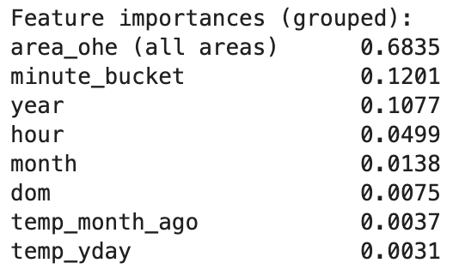
Machine Learning Findings & Application
Insights from Feature Importances
Community Area (location) dominates demand prediction
Minute bucket, year, and hour are key temporal drivers
Weather features (temperature, precipitation) had comparatively low importance
  May suggest behavioral + location factors outweigh weather variations, although Random Forest captures non linear relationships between columns
Test RMSE: 32.42626069813452
Test R²: 0.7757461502014218
Low Error (< 10): ~48 community areas – model is highly reliable
Medium Error (10–25): 17 community areas – acceptable, but can be improved with richer features
High Error (≥ 25): 13 community areas – highly volatile / event-driven demand; candidate for specialized models
High-RMSE areas likely correspond to special zones (airports, stadiums, or downtown hotspots) where demand is dominated by events and extreme peaks, which our current feature set doesn’t fully capture yet.
Notes:
numTrees=50, # smaller for now
maxDepth=8,
maxBins=32,

Slide 8
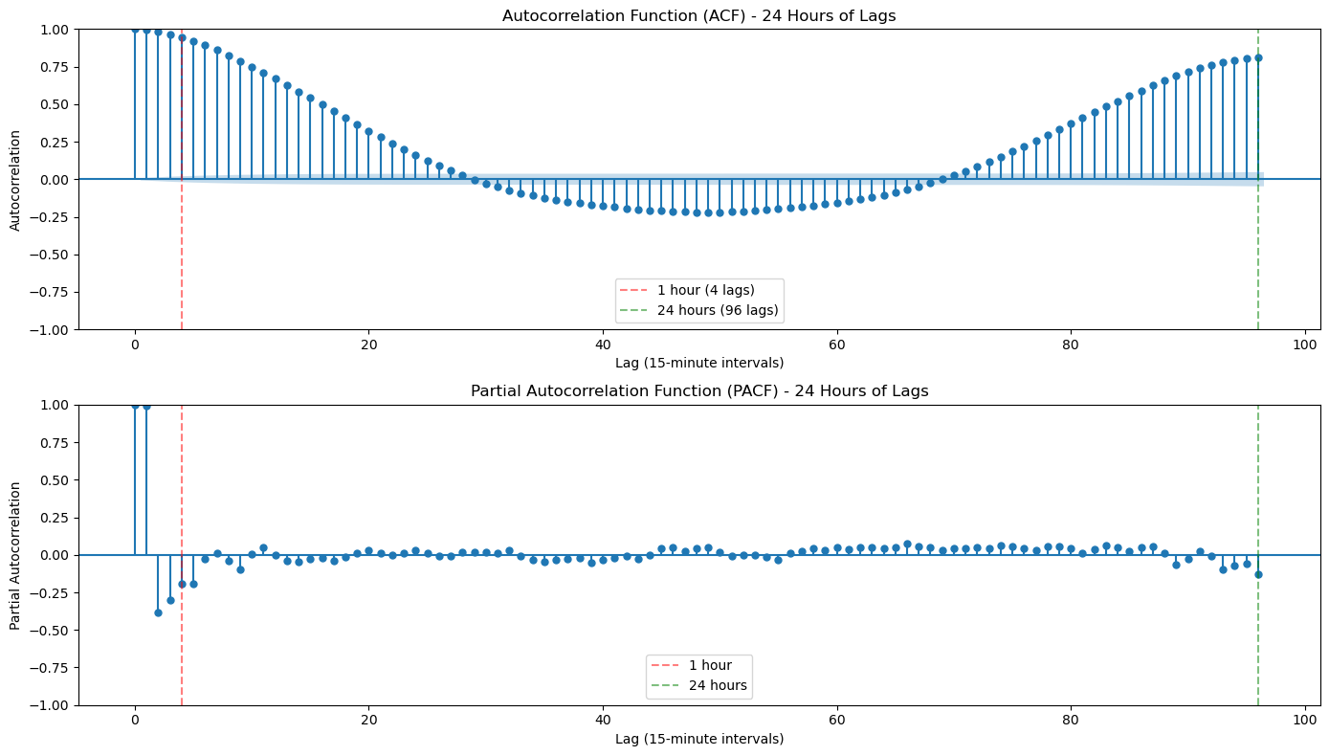
Findings: Time has Significant Predictive Power
ACF (Top): How similar the data is to itself at different time delays (Lags)
Demand is consistent within hour
Demand at a time today strongly correlates to same time tomorrow
PACF (Bottom): "How correlated is demand now with demand 2 hours ago, after removing influence of everything in between?"
To predict next 15 minutes, just need to know what happened in last 15 minutes
Notes:
Explaining ACF: I can go into greater technical detail as to what these two graphs show during the Q&A but for the sake of time and clarity I will just discuss their implications.
Top: The two key takeaways from the top Autocorrelation Function (ACF) function are that it shows demand is both consistent within the hour and at the same time across days.
For the first point this means that the demand at 5:00 PM is highly effective in predicting demand at 5:15 PM, 5:30 PM, 5:45 PM, and 6:00 PM with considerable predictive effects existing for a good period of time outside of that range
For the second point this implies that the demand at 5:00 PM today is highly correlated to the demand tomorrow at 5:00 PM. This is logical, especially during the week, because people’s behavioral patterns are likely similar at the same time on both Monday and Tuesday.
Bottom: For the bottom Partial Autocorrelation Function (PACF) graph this reinforces the idea that the demand 15-minutes prior to any given time is the most important in predicting demand.
For example, the demand at 5:00 PM ALONE is very effective in predicting demand at 5:15 PM, because demand at 4:45 PM will add very little new information to the prediction that isn’t already captured by the demand at 5:00 PM

Slide 9
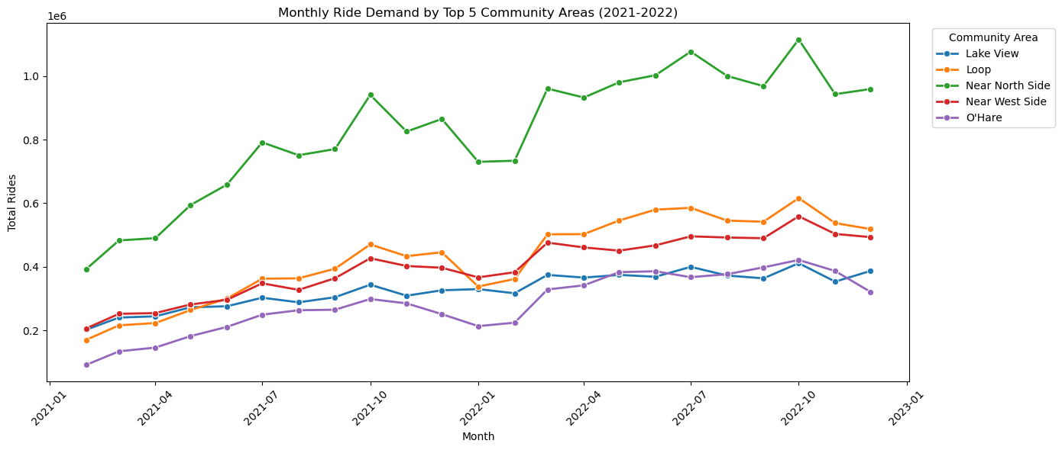
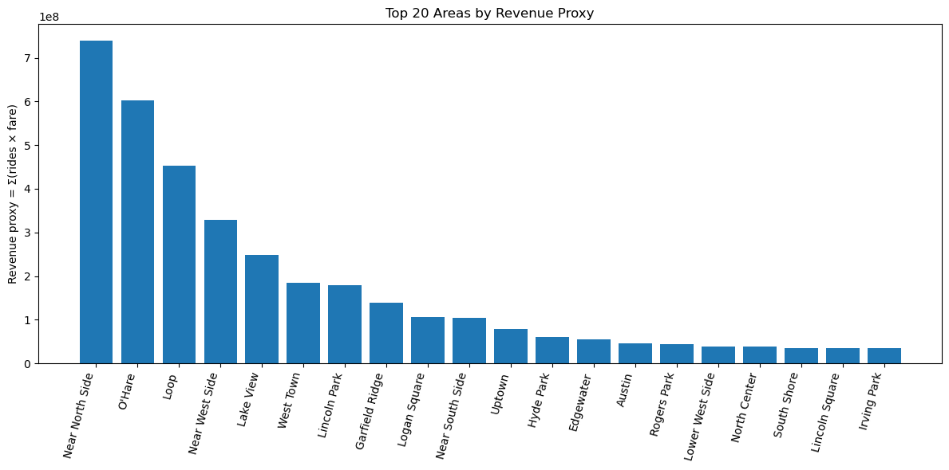
Findings: Demand is Concentrated in a few Areas
Top 5 Areas by DMD & Rev: Near North Side, Loop, Near West Side, Lake View, O’hare (Airport)
Top Areas have continued to grow after the Pandemic
The Near North Side is one of the most vibrant and heavily trafficked areas in Chicago, having some of Chicago’s biggest attractions, a dense dining and nightlife scene, high-income residences, large employers, easy transportation access, and many hotels

Slide 10
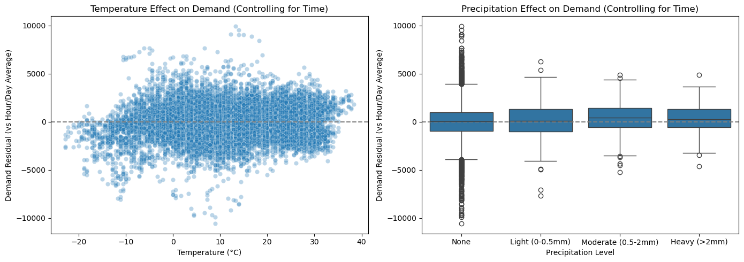
Findings: Weather Does NOT Impact Demand
Demand is consistent at all temperatures
Demand is unaffected by precipitation
Team was shocked by this finding, as personal experiences suggested a strong relationship between weather and demand. It was the main reason we brought in extra weather data for this Phase.

Slide 11
Recommendations
For drivers
Focus on high-demand areas
Concentrate operations in top-volume neighborhoods to maintain consistent trips and stable earnings
Leverage ML predictions
Use model-identified peak times and hotspots to optimize driver positioning and support better trip planning
Unlock emerging area value
Target lower-demand but high-potential neighborhoods to expand service coverage and support local development
Market-wide applicability
Insights can be extended to other major U.S. metro areas for broader implementation
Need for updated data
Refresh the analysis with post-2022 data to reflect recent economic shifts and improve model performance.
Notes:
Key Recommendations:
For drivers: Focus on high-demand areas. Concentrate operations in top-volume neighborhoods to maintain consistent trips and stable earnings.
Leverage ML predictions: Use model-identified peak times and hotspots to optimize driver positioning and support better trip planning.
Unlock emerging area value: Target lower-demand but high-potential neighborhoods to expand service coverage and support local development.
Market-wide applicability: Insights can be extended to other major U.S. metro areas for broader implementation.
Need for updated data: Refresh the analysis with post-2022 data to reflect recent economic shifts and improve model performance.

Slide 12
Challenges & Limitations
Resource Constraints
Exhausted credits from over-provisioned clusters
Kernel crashes on configuration optimized for cost, not heavy analysis
Forced to compromise on ML depth, illustrating that big data insights require substantial resources and careful planning
Workflow Inefficiencies
Ran analyses in cluster but completed write-ups in Colab after manually downloading/merging files
Achieved cost and collaboration goals but created cumbersome manual work and difficult change implementation
Data Limitations
Poor pre-pandemic data quality restricted analysis to Feb 2021-late 2022
Economic changes since 2022 create uncertainty around model reliability, though core insights likely remain valid
Notes:
Resource constraints: We used up our credits because we first chose clusters that were too large. Later, when we switched to cheaper setups, the kernel often crashed when we ran analyses at the same time. This limited how deep we could go with ML and how creative we could be, and it showed that big data work needs both resources and careful planning—not just coding.
Workflow inefficiencies: To reduce costs and avoid conflicts, we ran the analysis on the cluster but wrote the report in Colab after manually downloading and merging files. This helped with cost control and collaboration, but it added extra manual work and made changes harder, showing both the strengths and limits of cloud + notebook workflows.
Data limitations: Because the pre-pandemic data quality was poor, we mainly used post-pandemic data (Feb 2021 to late 2022). This gave us less data than expected. Since the economy has changed a lot after 2022, our results and ML model performance may be less reliable today, even though we think the main insights are still meaningful.

Slide 13
Thank You | Q&A

Slide 14
Sources
1. Alphabet Inc. (n.d.). Google Gemini. Google. https://gemini.google.com/
2. Anthropic PBC. (n.d.). Claude.AI. Anthropic. https://www.anthropic.com/
3. City of Chicago. (2023, March 29). Transportation network providers - trips (2018 - 2022): City of Chicago: Data Portal. Chicago Data Portal. https://data.cityofchicago.org/Transportation/Transportation-Network-Providers-Trips-2018-2022-/m6dm-c72p/about_data
4. City of Chicago. (2024, February 7). Taxi trips (2013-2023): City of chicago: Data Portal. Chicago Data Portal. https://data.cityofchicago.org/
Transportation/Taxi-Trips-2013-2023-/wrvz-psew/about_data
5. National Oceanic and Atmospheric Administration. (n.d.). Integrated Surface Dataset (Global) (Version Superseded). National Centers for Environmental Information (NCEI). https://www.ncei.noaa.gov/access/search/data-search/global-hourly
6. OpenAI. (n.d.). ChatGPT. OpenAI. https://openai.com/
7. Soltanieh Ha, M. (2025). BA843 E1 Big Data Analytics for Business (Fall 25). Lectures 1-13. Boston ; Boston University: Questrom School of Business.

